Slide 1



UNIT 5: Where I live
People in my neighbourhood

Slide 2
Is your neigbourhood similar to Ollie’s town?
How is it different?
Do you know the people who live close?
Who’s your most interesting neighbour? Why?

Slide 3
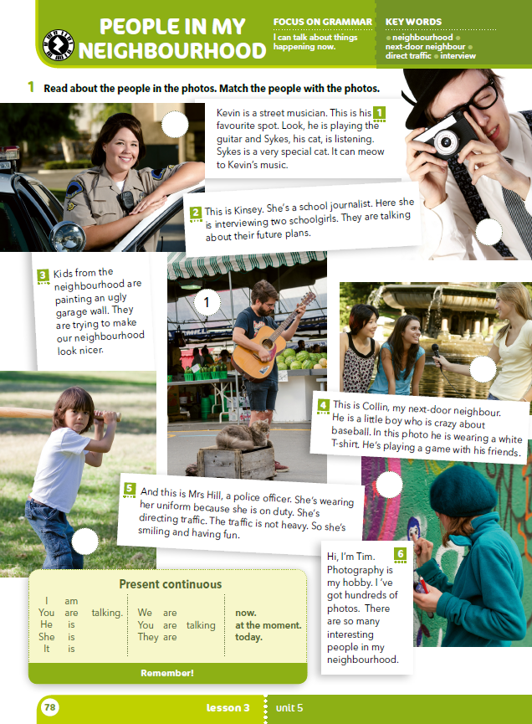
Look at the photos and answer the questions.
What can you see in the photos?
What are the people wearing?
What are they doing?

Slide 4
Read the texts and match the texts with the photos.
5
6
2
3
4

Slide 5
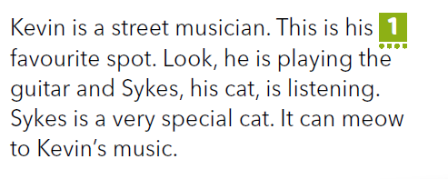
Read the sentence that is underlined in red.
When is he playing the guitar? Every day, every week or now?
Now.
Underline the verb in this sentence.

Slide 6
Look, he is playing the guitar.
pomoćni glagol
glagol + -ing (play + ing)
Pronađi i podcrtaj sve primjere glagola + ing i riječi koja stoji ispred njega u tekstovima.

Slide 7
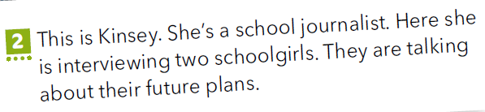
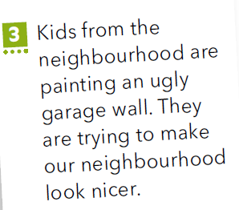
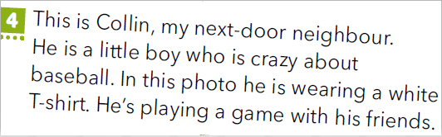
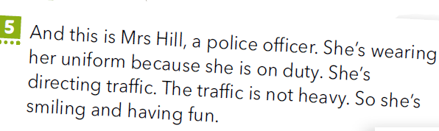

Slide 8
is
are + verb + -ing
am
Copy the sentences from the chart in your notebook.
I | am | taking a photo.
He She It | is | playing the guitar.
We You They | are | talking.

Slide 9
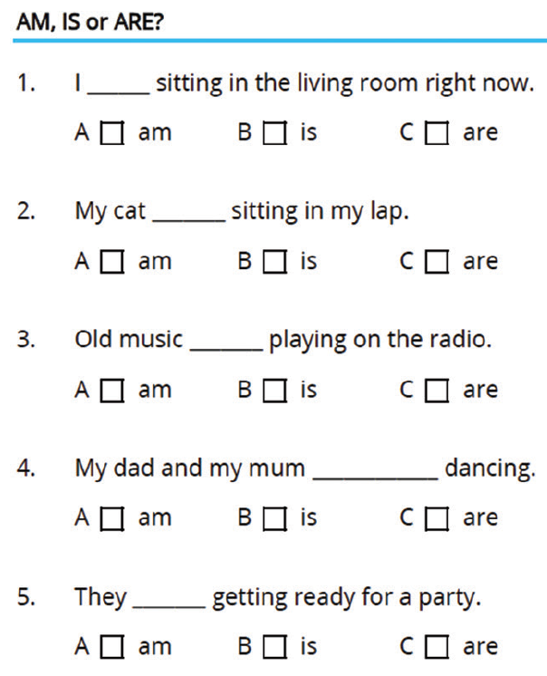
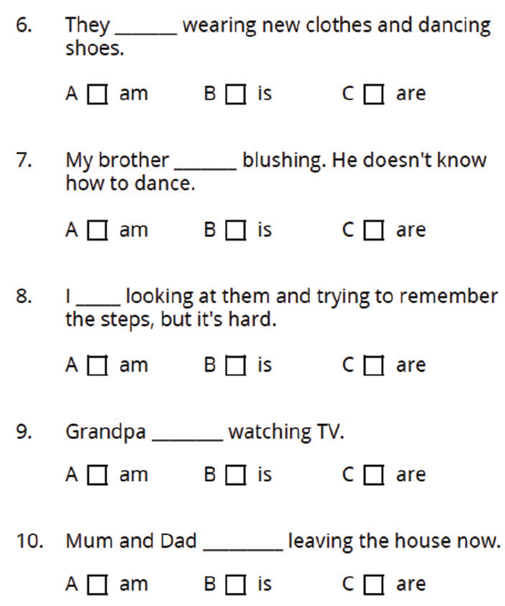
Fill in the gaps with the correct word (am, is or are).
am
are
is
is
is
am
are
is
are
are

Slide 10
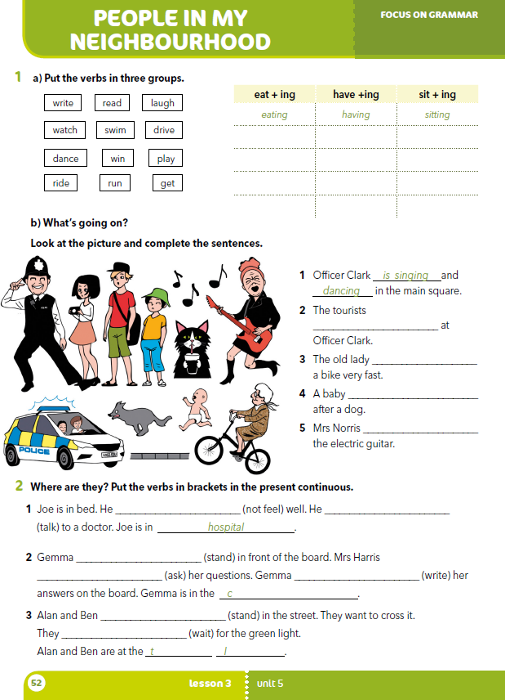
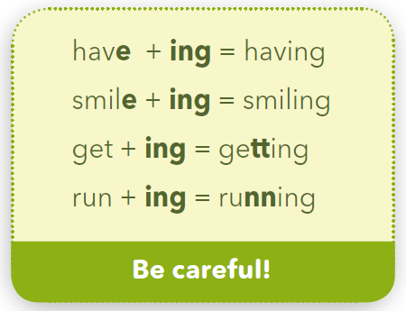
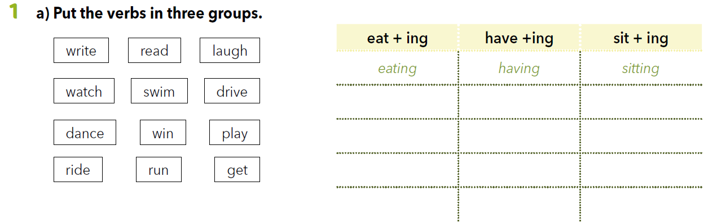
Workbook p 52.
have → have + ing→ having
sit → sit + t + ing→ sitting
reading
laughing
watching
playing
writing
driving
dancing
riding
swimming
winning
running
getting

Slide 11
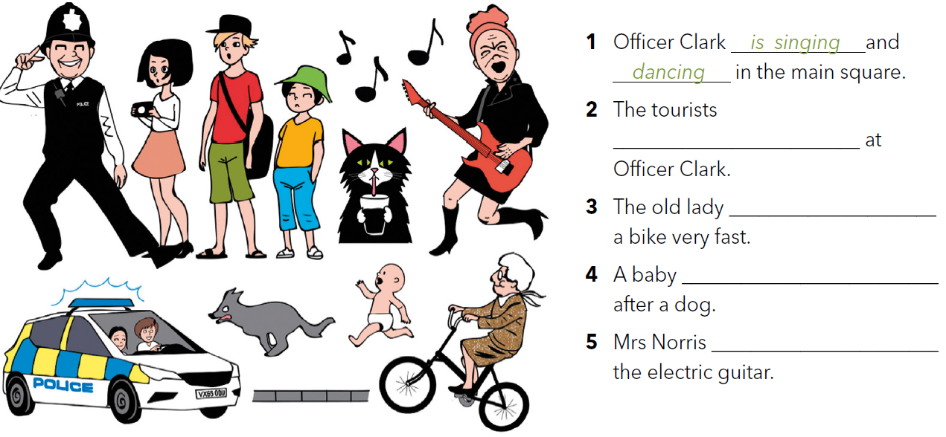
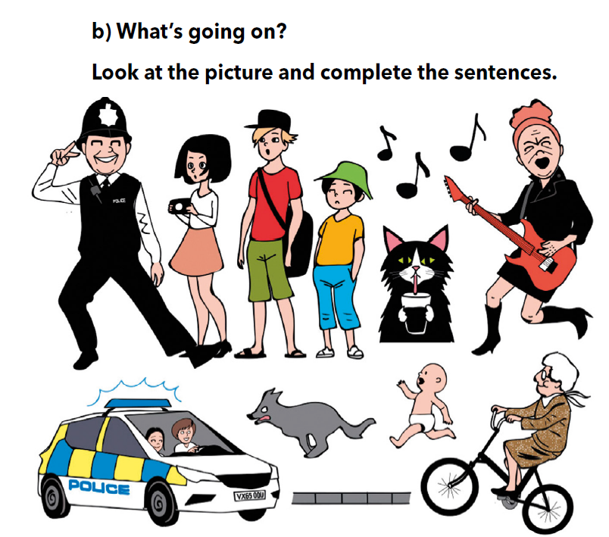
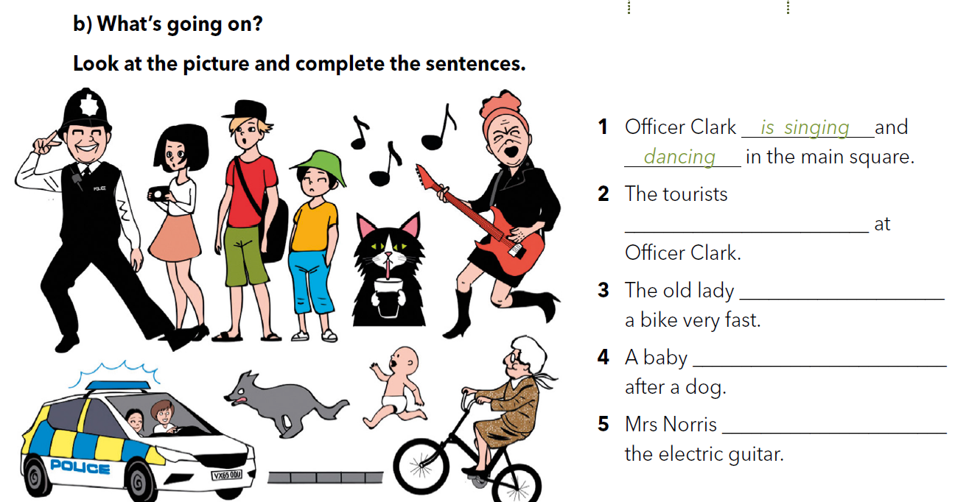

are looking
What are they doing? Look at the picture and describe it in full sentences.
is riding
is running
is playing

Slide 12
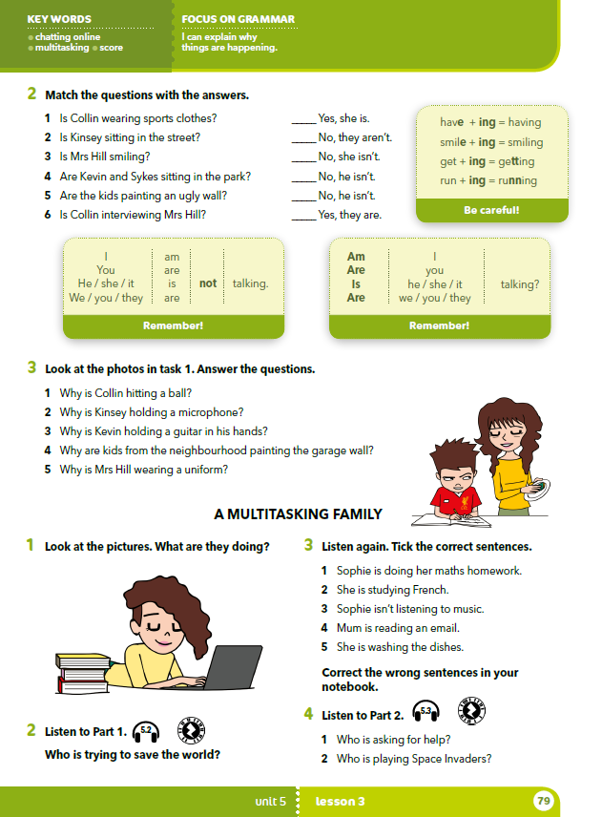
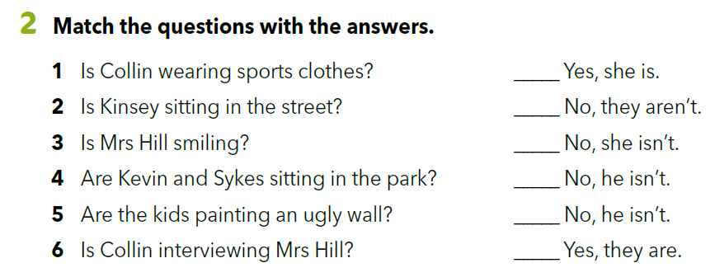
3
4
2
1
6
5

Slide 13
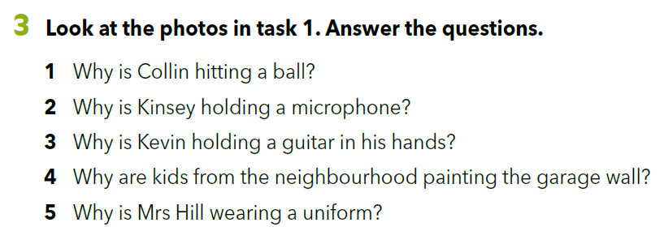

Slide 14
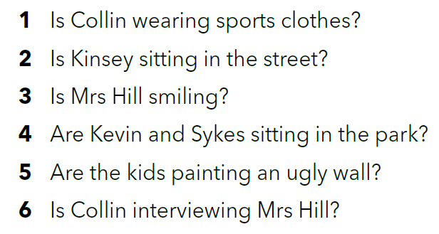
is/are + ….ing

Slide 15
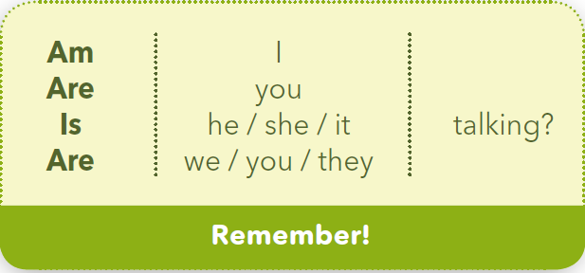
questions in the present continuous tense
Mrs Hill is smiling.
Is Mrs Hill smiling?
The kids are painting an ugly wall.
Are the kids painting an ugly wall?

Slide 16
negative sentences in the present continuous tense
Collin is wearing sports clothes.
Collin is not (isn’t) wearing sports clothes.
Kevin and Sykes are sitting in the park.
Kevin and Sykes are not (aren’t) sitting in the park.
I am playing the guitar.
I am not (’m not) playing the guitar.

Slide 17
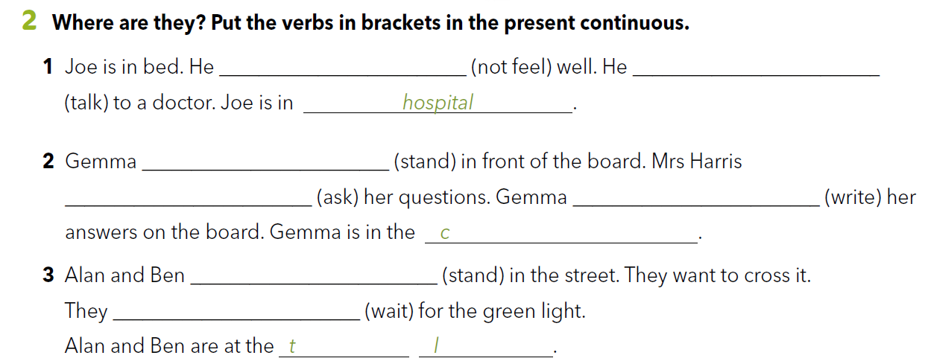
Workbook p 52.
is not feeling / isn’t feeling
is talking
is standing
is asking
is writing
lassroom
are standing
are waiting
raffic ights
Practise:
.
https://www.bookwidgets.com/play/t:Av7PXgY2cmMDjdGxKqLnZpcEU/ZDukFqUmYNpzyZzp5DRU5NUlY=

Slide 18

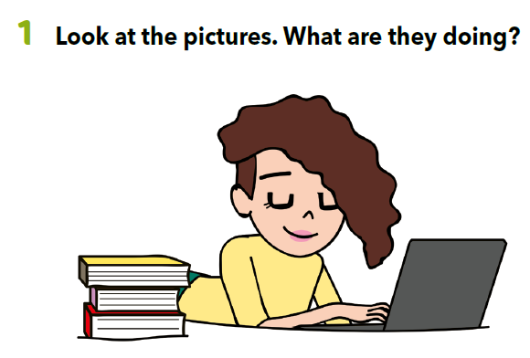
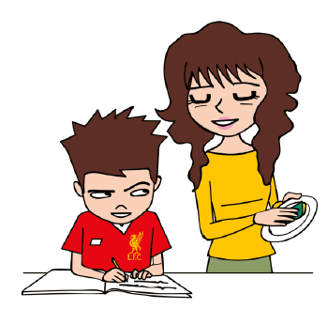

Slide 19


https://www.e-sfera.hr/dodatni-digitalni-sadrzaji/b0be3b2e-c7fc-4dbd-a517-b4839109dc8d/assets/audio/35_multitasking_family_part_1.mp3
Sophie is trying to save the world.
How often do you do your homework?
Do you help your parents do housework?
Do you think housework is difficult?

Slide 20
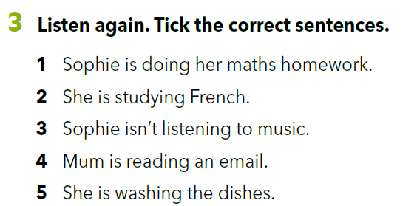
✓
✓
Listen and check your answers.
https://www.e-sfera.hr/dodatni-digitalni-sadrzaji/b0be3b2e-c7fc-4dbd-a517-b4839109dc8d/assets/audio/36_multitsking_family_part_2.mp3

Slide 21
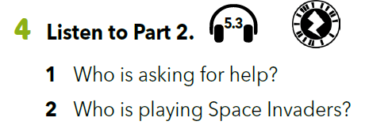
Listen to the Part 2 and answer the questions.
Sophie is asking for help.
Mum is playing Space Invaders.
https://www.e-sfera.hr/dodatni-digitalni-sadrzaji/b0be3b2e-c7fc-4dbd-a517-b4839109dc8d/assets/audio/36_multitsking_family_part_2.mp3

Slide 22
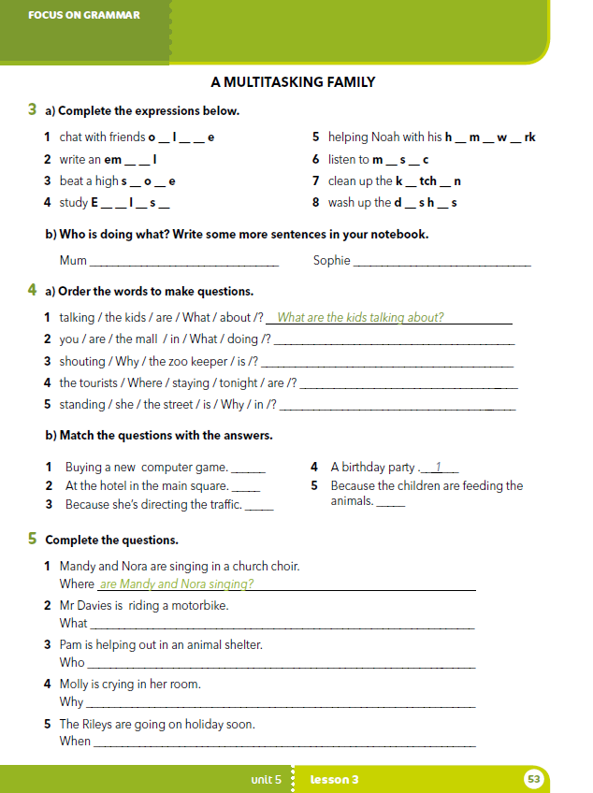
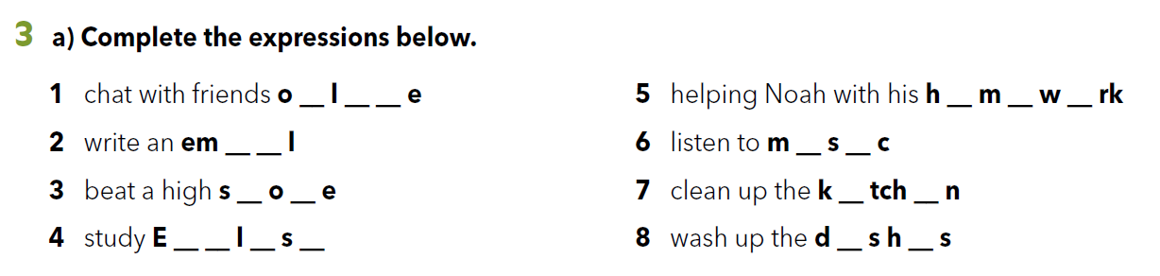
Workbook p 53.
n i n
o e o
Mum is washing the dishes. Sophie is chatting with her friends.
Mum is writing an email. Sophie is doing her maths homework.
Mum is helping Noah. Sophie is studying English.
Mum is cleaning the kitchen. Sophie is listening to music.
a i
u i
c r
i e
n g i h
i e

Slide 23
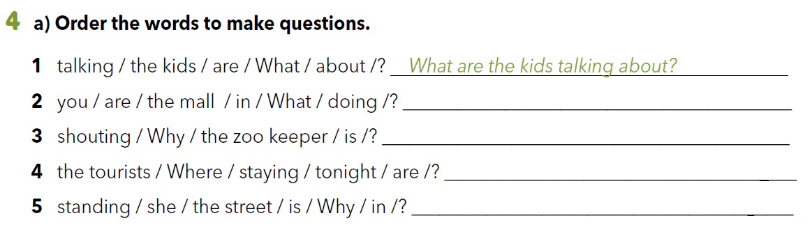
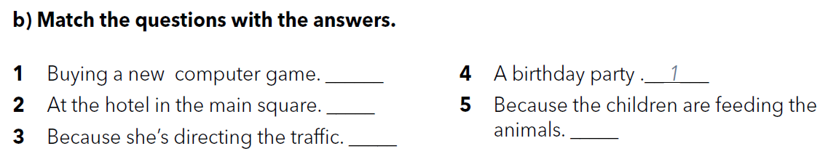
What are you doing at the mall?
Why is the zoo keeper shouting?
Where are the tourists staying tonight?
Why is she standing in the street?
Poveži pitanja iz zadatka 4a s odgovorima.
2
4
5
3

Slide 24
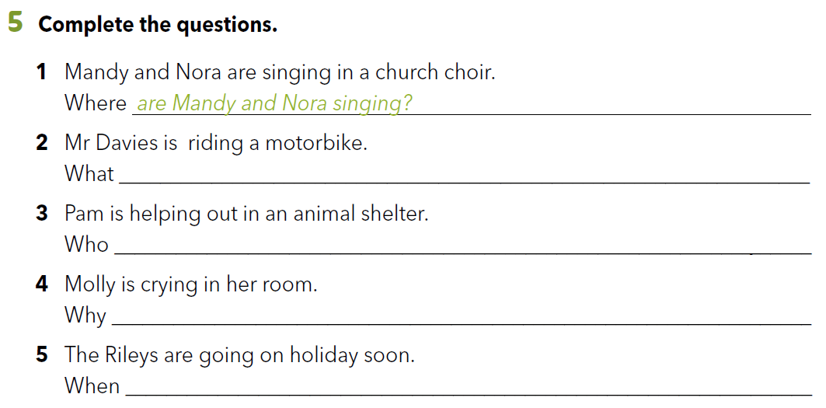
is Mr Davies riding?
is helping out in an animal shelter?
is Molly crying in her room?
are the Rileys going on a holiday?

Slide 25
Let’s practise!
https://reviewgamezone.com/game.php?id=23218

Slide 26

LEARN MORE.
https://www.e-sfera.hr/dodatni-digitalni-sadrzaji/b0be3b2e-c7fc-4dbd-a517-b4839109dc8d/
People in my home

Slide 27
LEARN MORE.
https://www.e-sfera.hr/dodatni-digitalni-sadrzaji/b0be3b2e-c7fc-4dbd-a517-b4839109dc8d/

